Slide 2
sampleID | read-90bp-mapped-550of1000-align-ident | bwa-NM | #-of-reads-90bp-mapped
99 | 92.39 | 6 | 583
123 | 93.55 | 5 | 589
100 | 94.44 | 5 | 594
105 | 94.44 | 5 | 610
102 | 94.44 | 5 | 615
113 | 94.44 | 5 | 615
108 | 94.44 | 5 | 617
101 | 95.56 | 4 | 623
97 | 95.56 | 4 | 657
106 | 95.56 | 4 | 640
86 | 96.67 | 3 | 687
78 | 96.67 | 3 | 693
93 | 96.67 | 3 | 673
94 | 96.67 | 3 | 682
98 | 96.67 | 3 | 685
104 | 96.67 | 3 | 673
107 | 96.67 | 3 | 657
80 | 96.7 | 3 | 678
81 | 96.7 | 3 | 697
88 | 96.7 | 3 | 687
96 | 96.74 | 3 | 670
87 | 97.78 | 3 | 684
90 | 97.78 | 3 | 698
74 | 97.78 | 3 | 687
77 | 97.78 | 3 | 697
85 | 97.78 | 3 | 682
89 | 97.78 | 3 | 687
84 | 97.78 | 3 | 131
Set bwa edit distance parameter such that at least 55% of reads can be mapped
For each sample, randomly select 1000 90-bp reads (choose 1 read per 120k sequences). Blast 1000 reads against apple ref. genome
Count how many reads that are 90-bp aligned
550th read’s identity
Determine edit distance (-NM) for bwa mapping
Using more relaxed bwa alignment parameters for more remotely related species.
Assume that 55% reads should be able to be aligned to the ref genome.
No contaminations.
Since whole read (90-bp) was mapped, no adaptor / barcode in the read;
These 550 mapped reads be random. (20% reads identity 100% ; 15% reads id 99%; 10% reads id. 98%, … ,92% , …, until 1e-15)
200 reads contaminated.
800 reads non contaminated.
550/800 reads mapped.

Slide 3
sample | Apple id 99 | Id 99
Raw basee |  | 13 Gb (6.5 + 6.5)
Genome coverage | 65.9% (255,643,405) | 74% (286,133,031)
Bwa parameter | -n 3 –o 1 (90bp) | -n 6 –o 2
Substitute rate | 1.79% (4,513,678 / 252,375,633) | 2.07% (5,819,143 / 281,540,397)
indel | 813,021 | 909,117
Heterozygosity | 0.48% (1,234,823/255,643,405) 66055 CG 121579 GT 123151 AC 142497 AT 390558 CT 390983 AG | 0.79% (2,262,064 / 286,133,031) 116017 CG 216293 GT 217680 AC 247142 AT 731431 CT 733501 AG
Chloroplast substitution rate | 0.13% (144 / 108712) | 0.13% (143 / 108680 )
Mitochondrial substitution rate | 0.058% (209 / 359758) | 0.060 % (217 / 359776 )

Slide 4
grep " [ACGT] [ACGT] [ACGT]$" temp.ref.nm3.nm6.5colum > temp.ref.nm3.nm6.A-A-A.5colum
ref is A/C/G/T, -n 3 is A/C/G/T, -n 6 is A/C/G/T,
All single nucleotide sites. Sites covered by both –n 3 & -n 6 mapping. | 248,836,587
Identical genotype by –n 3 & -n 6 | 248,741,858 (99.96%)
# of SNPs by “-n 3” | 4,177,438 (1.68%)
# of SNPs by “-n 6” | 4,164,456 (1.67%, less than –n 3)
Identical SNPs by –n 3 & -n 6 | 4,122,445
grep " [ACGT] [N] [ACGT]$" temp.ref.nm3.nm6.5colum > temp.ref.nm3.nm6.A-N-A.5colum
wc -l temp.ref.nm3.nm6.A-N-A.5colum
32,375,747 temp.ref.nm3.nm6.A-N-A.5colum
awk '$3 != $5' temp.ref.nm3.nm6.A-N-A.5colum | head
chr10 460 G N A
awk '$3 != $5' temp.ref.nm3.nm6.A-N-A.5colum | wc -l
1,579,918
1579918 / 32375747 = 4.88%
in ~30 Mbp region only covered/genotyped by –n 6 mapping, substition rate is ~5%

Slide 5
Bwa –n 6
FCC2UPNACXX:6:1104:1311:61493#GGTGACTT 89 chr13 34061578 0 90M = 34061578 0 GTGCCCCTCAACACAGAGGGTCACCTTCATTCGACATGGGTATCCCTGATGAGGAGTGAGTTAATCATCAAAACATTGATCAACATGAGA XT:A:R NM:i:4 SM:i:0 AM:i:0 X0:i:8 X1:i:31 XM:i:4 XO:i:0 XG:i:0 MD:Z:7C20C27C3C29 mate not mapped
Bwa –n 3
FCC2UPNACXX:6:1104:1311:61493#GGTGACTT 99 chr15 11954419 29 82M1I7M = 11954784 447 TCTCATGTTGATCAATGTTTTGATGATTAACTCACTCCTCATCAGGGATACCCATGTCGAATGAAGGTGACCCTCTGTGTTGAGGGGCAC XT:A:U NM:i:3 SM:i:29 AM:i:29 X0:i:1 X1:i:0 XM:i:2 XO:i:1 XG:i:1 MD:Z:33G41C13 mate mapped with NM:13. mate mapping generates SNP.
FCC2UPNACXX:6:1104:1311:61493#GGTGACTT 147 chr15 11954784 29 8S19M1D2M1I60M = 11954419 -447 CAAAGCTGAAGAGAGTAAGAATAAGTGCGTTTCCCACAGACGGTGCCAAATGTTGATTTACAAAATCAACGAGGACTTTGGTACAATAGA XT:A:M NM:i:13 SM:i:29 AM:i:29 XM:i:11 XO:i:2 XG:i:2 MD:Z:8G0G9^T12T2C7A5G0C9G0T10T5C3
chr15 17468848 C A C
Bwa –n 6
FCC2UPNACXX:5:2207:4006:59004#GGTGACTT 89 chr2 25982578 0 90M = 25982578 0 CATTCATGAGCATCACTCATGTCAATCTAGCTTCGAAAGCTTCATTTACAGAGTTCTAGCTTCAAAAGCTTTATTTACAAAAGCTCCAGC XT:A:R NM:i:4 SM:i:0 AM:i:0 X0:i:2 X1:i:2 XM:i:4 XO:i:0 XG:i:0 MD:Z:9T43C17C14T3 XA:Z:chr17,-26629081,90M,4;chr15,+50390074,90M,5;chr7,+17448766,90M,5; mate not mapped
Bwa –n 3
FCC2UPNACXX:5:2207:4006:59004#GGTGACTT 83 chr15 17469221 29 27M1I62M = 17468795 -515 CATTCATGAGCATCACTCATGTCAATCTAGCTTCGAAAGCTTCATTTACAGAGTTCTAGCTTCAAAAGCTTTATTTACAAAAGCTCCAGC XT:A:U NM:i:3 XN:i:1 SM:i:29 AM:i:29 X0:i:1 X1:i:0 XM:i:2 XO:i:1 XG:i:1 MD:Z:52C17C18
FCC2UPNACXX:5:2207:4006:59004#GGTGACTT 163 chr15 17468795 29 1S34M1I19M2I7M1I3M2I16M4S = 17469221 515 AATTTATTTTTCTTATCTTTCAGAGACATCTGTATAAACCCCATCAGATGGTAATAAAAATAAATAAATTAAATTAAAAAAAAAAGGGCA XT:A:M NM:i:13 XN:i:1 SM:i:29 AM:i:29 XM:i:7 XO:i:4 XG:i:6 MD:Z:13G6G25G6C1C10A0C11

Slide 6
ref is Y ([CT]), -n 3 is genotyped, -n 6 is genotyped, 371,364 sites
 | -n 3 | -n 6
Genotype is [CT] | 8920 (2.40%) | 12172 (3.28%)
Genotype is C or genotype is T | 351914 (94.8%) | 348554 (93.9%)
sum | 97.2% | 97.2%
-n 6: ref is [CT], genotype is [CT], 13664 / 445477 = 3.07%
ref is W ([AT]), -n 3 is genotyped, -n 6 is genotyped, 158,608 sites
 | -n 3 | -n 6
Genotype is [AT] | 3438 (2.17%) | 4515 (2.85%)
Genotype is A or genotype is T | 142996 (90.2%) | 142123 (89.6%)
Sum | 92.4% | 92.4%
-n 6: ref is [AT], genotype is [AT], 4916 / 185630 = 2.65%
ref is M ([AC]), -n 3 is genotyped, -n 6 is genotyped, 126,573 sites
 | -n 3 | -n 6
Genotype is [AC] | 2465(1.95%) | 3213 (2.5%)
Genotype is A or genotype is C | 116005 (91.7%) | 115164 (91.0%)
Sum | 93.6% | 93.5 %
n 6: ref is [AC], genotype is [AC], 3509 / 149838 = 2.34%

Slide 7
Dynamically set bwa edit distance parameter such that ~70%of reads can be mapped. 60% reads are properly paired which are used for genotyping.

Slide 8
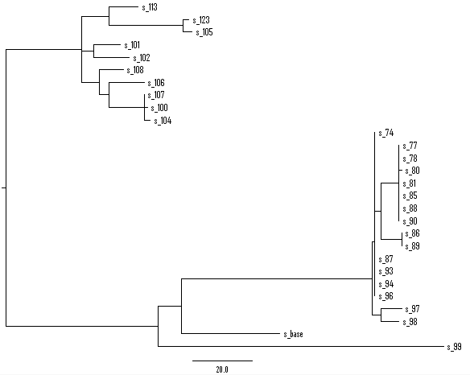
Chloroplast
27 samples + ref (28 accessions)
387 SNP sites (no indel, no heterozygous genotype, no N, at least 1 snp)
MP method
Tree length = 403
CI excluding uninformative characters = 0.9252
Notes:
Of 387 total characters:
All characters are of type 'unord'
All characters have equal weight
189 characters are parsimony-uninformative
Number of parsimony-informative characters = 198
Gaps are treated as "missing"
Character-state optimization: Accelerated transformation (ACCTRAN)
Tree number 1 (rooted using default outgroup)
Tree length = 403
Consistency index (CI) = 0.9603
Homoplasy index (HI) = 0.0397
CI excluding uninformative characters = 0.9252
HI excluding uninformative characters = 0.0748
Retention index (RI) = 0.9884
Rescaled consistency index (RC) = 0.9491

Slide 9
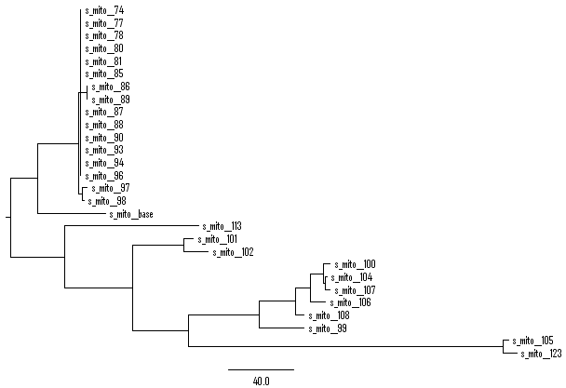
mitochondrial
27 samples + ref (28 accessions)
551 sites (no indel, no heterozygous genotype, no N)
MP method
Tree length = 652
CI excluding uninformative characters = 0.8124
Notes:
paup> describetrees 1 / Plot = Phylogram
Tree description:
Unrooted tree(s) rooted using outgroup method
Optimality criterion = parsimony
Character-status summary:
Of 551 total characters:
All characters are of type 'unord'
All characters have equal weight
150 characters are parsimony-uninformative
Number of parsimony-informative characters = 401
Gaps are treated as "missing"
Character-state optimization: Accelerated transformation (ACCTRAN)
Tree number 1 (rooted using default outgroup)
Tree length = 652
Consistency index (CI) = 0.8558
Homoplasy index (HI) = 0.1442
CI excluding uninformative characters = 0.8124
HI excluding uninformative characters = 0.1876
Retention index (RI) = 0.9355
Rescaled consistency index (RC) = 0.8006

Slide 10
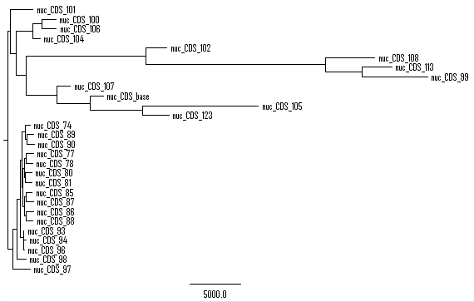
nuclear
27 samples + ref (28 accessions)
48439 sites (no indel, no heterozygous genotype, no N, minor Allele freq >= 3)
MP method
Tree length = 100260
CI excluding uninformative characters = 0.4836
Notes:
describetrees 1/plot=cladogram
Tree description:
Unrooted tree(s) rooted using outgroup method
Optimality criterion = parsimony
Character-status summary:
Of 48439 total characters:
All characters are of type 'unord'
All characters have equal weight
All characters are parsimony-informative
Character-state optimization: Accelerated transformation (ACCTRAN)
Tree number 1 (rooted using default outgroup)
Tree length = 100260
Consistency index (CI) = 0.4836
Homoplasy index (HI) = 0.5164
Retention index (RI) = 0.6399
Rescaled consistency index (RC) = 0.3095

Slide 11
Table 1. CI & RI of the MP-based trees
 | SNP sites | consistency index (CI) excluding uninformative characters | Retention index (RI)
Chloroplast | 387 | 0.93 | 0.99
Mitochondria | 551 | 0.81 | 0.94
Nuclear (MAF >= 3) | 48439 | 0.48 | 0.64

Slide 12
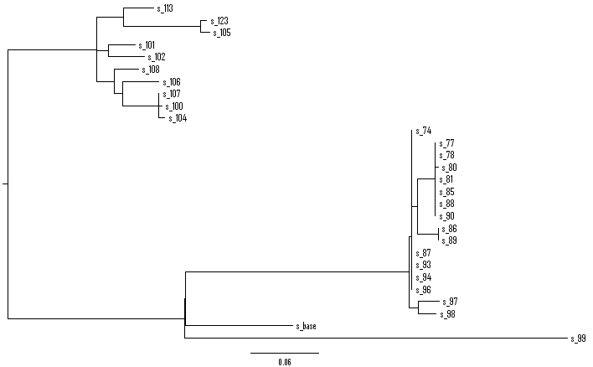
Chloroplast
27 samples + ref (28 accessions)
387 SNP sites (no indel, no heterozygous genotype, no N, at least 1 snp)
ML method
Notes:
paup> describetrees all/plot=phylogram
Tree description:
Unrooted tree(s) rooted using outgroup method
Optimality criterion = likelihood
Likelihood settings:
Number of substitution types = 2
Transition/transversion ratio estimated via ML
Assumed nucleotide frequencies (set by user):
A=0.25000 C=0.25000 G=0.25000 T=0.25000
Among-site rate variation:
Assumed proportion of invariable sites = none
Distribution of rates at variable sites = gamma (discrete approximation)
Shape parameter (alpha) = estimated
Number of rate categories = 4
Representation of average rate for each category = mean
These settings correspond to the K80(K2P)+G model
Number of distinct data patterns under this model = 61
Molecular clock not enforced
Starting branch lengths obtained using Rogers-Swofford approximation method
Branch-length optimization = one-dimensional Newton-Raphson with pass limit=20, delta=1e-06
-ln L (unconstrained) = 1784.63841
Tree number 1 (rooted using default outgroup)
-Ln likelihood = 2375.49578
Estimated ti/tv ratio = 0.512433 (kappa = 1.024865)
Estimated value of gamma shape parameter = infinity (all sites have a relative rate of 1.0)

Slide 13
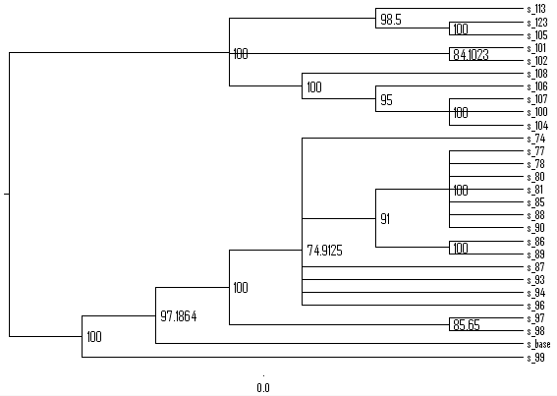
Chloroplast
27 samples + ref (28 accessions)
387 SNP sites (no indel, no heterozygous genotype, no N, at least 1 snp)
MP method, bootstrap
bootstrap nreps=200 treefile=boot.tre search=heuristic/ start=stepwise addseq=random nreps=10 swap=TBR;

Slide 14
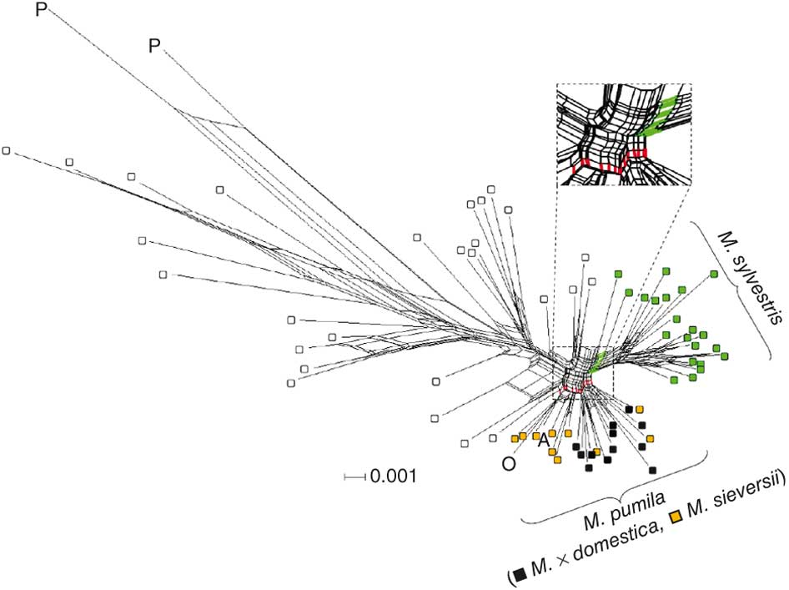
23 genes across the genus Malus
For each gene and accession, a PCR amplicon was resequenced and the data were analyzed as a concatenated data set with a total length of ~11,300 bp, with 1,507 polymorphic informative sites.
A neighbor-net planar graph¹⁶ was constructed from the molecular differences among accessions

